Slide 1

Automated Sinhala Voice Assistant to manage tasks using Natural Language Processing
2022-200
Supervised By:
Ms. Dinuka Wijendra
Co-Supervised By:
Ms. Jenny Kishara

Slide 2

Introduction
Over 4.2 billion digital voice assistants are being used in devices around the world [4].
Forecasts suggest that by 2024, the number of digital voice assistants will reach 8.4 billion units [4].
Many Asian countries have voice assistant applications with their native language (Korea – Clova) [5].
As Sri Lankans, We don’t have a voice assistant functioned using our native language.
English language-based voice assistant applications come with some challenges,
Mainly,
Accent issues in English
Lack of English literacy

Slide 3

Research Problem
Major vendors in the tech industry are not focused on local languages like Sinhala [6].
Some Sri Lankans, are not interested in English voice assistant applications due to accent issues and lack of English literacy.
During stressful situations, people do not like to have responses in foreign languages.
There is no existing automated voice assistant for locals in Sri Lanka.
Covid-19 pandemic has caused the distance between relatives and family members. Having a virtual assistant that cares about the users’ feelings will solve that.

Slide 4



Research Gap
Features | [1] | [2] | [3] | Proposed System ශ්‍රී Voice
Sinhala language
Speech-to-text
Text-to Sinhala speech
Provide answers in Sinhala voice output
Provide answers in Sinhala text output
Automating daily tasks
Facial expression detection
Suggestions generation according to the real time situation

Slide 5

Objectives
Main objective :
The Main objective is to increase the Sinhala voice commands used with the mobile phone daily and make it more accessible for the user's lifestyle while increasing mental health of the user.
Sub Objectives :
To develop a software component to :
Providing suggestions for users will allow them to enjoy and uplift mental health.
Improve the capability of providing the most relevant answers to the users.
Providing accurate English phrases for generated Sinhala phonetics.
Providing voice output as the suggestions to the users' requests.

Slide 6
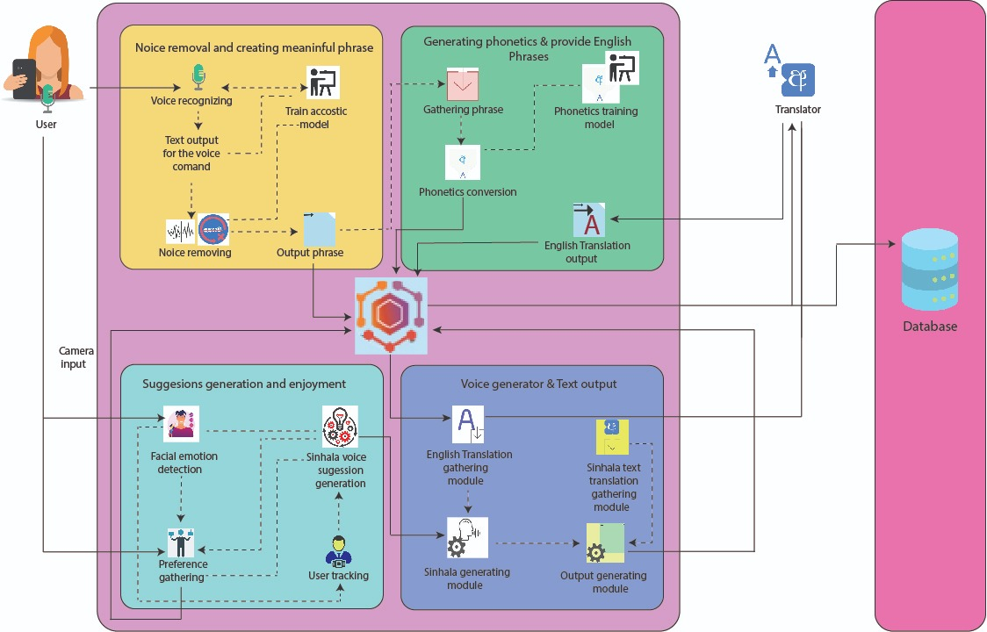
Overall System Overview Diagram

Slide 7

Technologies and Tools
Tools
Visual studio code
Jupiter notebook
Android studio
Technologies
Python
Dart
Flutter
TensorFlow
NumPy
Pandas
Firebase / MongoDB

Slide 8
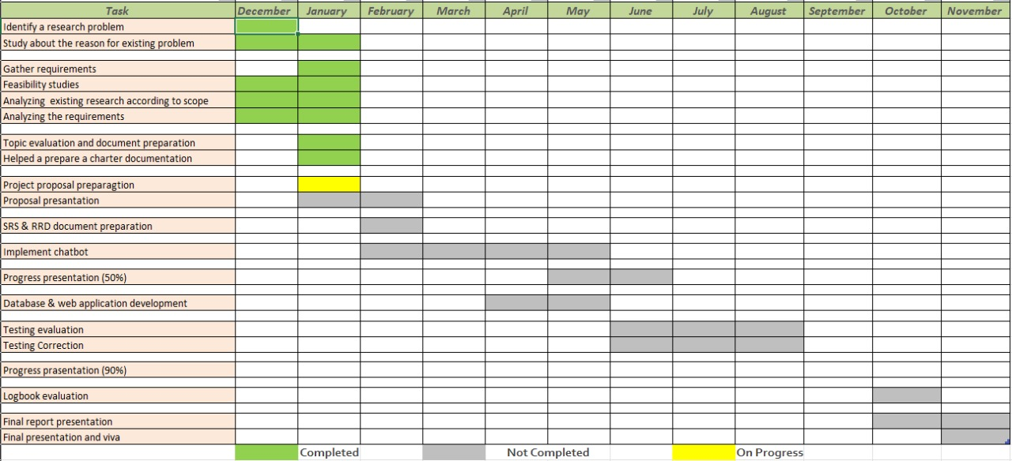
Evidence for the competition

Slide 9


Commercialization
The system will be fully moved to the cloud server once it has passed its initial testing phase. The service will then be advertised and offered to potential customers.
Targeted users,
People with accent issues in foreign languages
People who cannot speak English
People who value the Sinhala Language
The deployed application to the server can be commercialized using intro video demonstrations, Facebook banners, Social media posts, and ad campaigns.

Slide 10
References
[1] T. Dinushika, L. Kavmini, P. Abeyawardhana, U. Thayasivam and S. Jayasena, "Speech Command Classification System for Sinhala Language based on Automatic Speech Recognition," IEEE, 19 March 2020. [Online]. Available: https://ieeexplore.ieee.org/abstract/document/9037648. [Accessed 19 January 2022].
[2]"Intelligent mobile assistant for hearing impairers to interact with the society in Sinhala language", Ieeexplore.ieee.org, 2022. [Online]. Available: https://ieeexplore.ieee.org/abstract/document/8294116.
[3] D. D. S. Rajapakshe, K. N. B. Kudawithana, U. L. N. P. Uswatte, N. A. B. D. Nishshanka, A. V. S. Piyawardana and K. N. Pulasinghe, "Sinhala Conversational Interface for Appointment Management and Medical Advice," 2020 2nd International Conference on Advancements in Computing (ICAC), 2020, pp. 85-90, doi: 10.1109/ICAC51239.2020.9357155.
[4] "Number of voice assistants in use worldwide 2019-2024 | Statista", Statista, 2022. [Online]. Available: https://www.statista.com/statistics/973815/worldwide-digital-voice-assistant-in-use/.
[5] "Clova (virtual assistant) - Wikipedia", En.wikipedia.org, 2022. [Online]. Available: https://en.wikipedia.org/wiki/Clova_(virtual_assistant).
[6] G. D. a. A. Goonetilleke, "Development of Standards for Sinhala Computing," ICT Agency, Colombo, Sri Lanka, 2004,

Slide 11
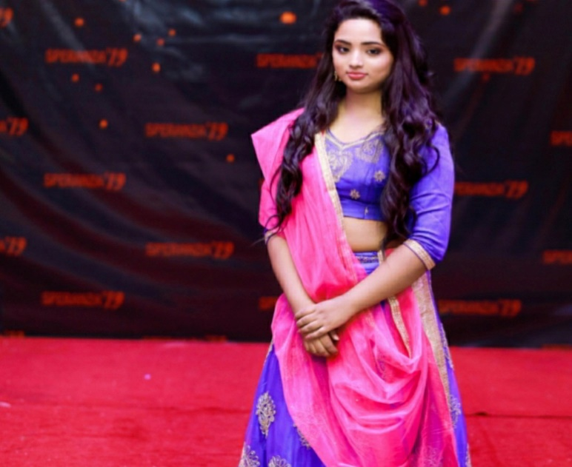
IT19808994 | Bandara V.D.
B.Sc. (Hons) Degree in Information Technology Specialized in
Interactive Media
IT19808994 | Bandara V.D. | 2022-200

Slide 12

INTRODUCTION
Noise Reduction and Creating Meaningful
Phrase
IT19808994 | Bandara V.D. | 2022-200

Slide 13

Research Questions
How to recognize users’ voice commands more accurately in the Sinhala language?
What are the words that should be filtered in the noise removal process?
How to avoid human errors in the voice recognition process in the Sinhala language?
IT19808994 | Bandara V.D. | 2022-200

Slide 14
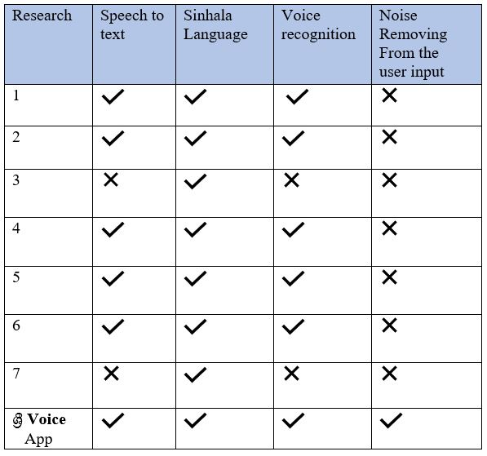
Research Gap
Existing research projects have not used noise removal methods for the Sinhala language.
Most existing research projects provide answers to a narrow range of questions.
Existing research projects are specified for some areas, not included all features provided by normal voice assistant apps.
The proposed System:
Remove the unwanted noise from the Sinhala voice command.
Can generate accurate phrases out of users’ initial voice commands.
IT19808994 | Bandara V.D. | 2022-200

Slide 15

Specific and Sub Objectives
Specific Objective
Improve the capability of providing the most relevant responses to the users’ voice commands. (By using unwanted noise reduction and creating a meaningful phrase)
Sub Objectives
Voice Recognition
Voice-to-text conversion
Noise Removal
Creating meaningful phrases out of users’ voice commands.
IT19808994 | Bandara V.D. | 2022-200

Slide 16

METHODOLOGY
IT19808994 | Bandara V.D. | 2022-200

Slide 17
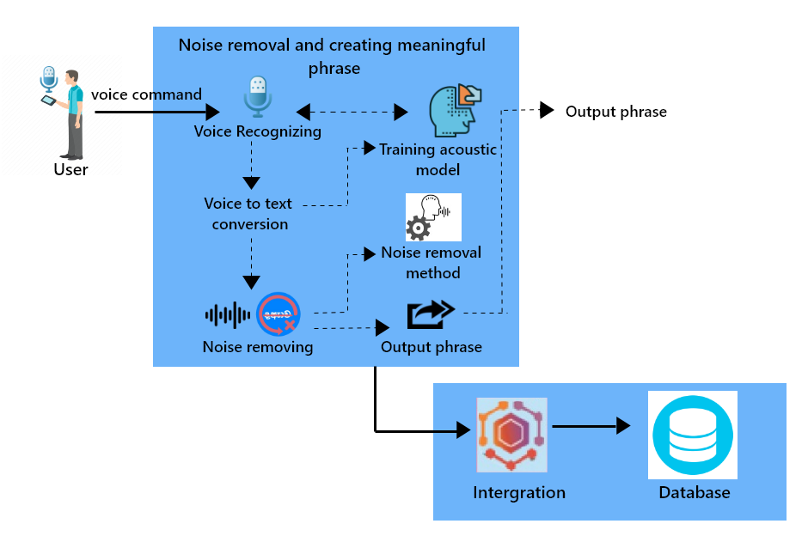
System Overview Diagram
IT19808994 | Bandara V.D. | 2022-200

Slide 18






Technologies/ Techniques/ Algorithms
Technologies / Tools
Python – Programming Language
Flutter – Front-end framework
Python Frameworks
Tensor flow, NumPy, Pandas - Libraries
Visual studio code, Jupiter notebook, Google Colab, Android Studio - IDE
MongoDB / Firebase - database server (data storage)
CMUSphinx – Voice recognition system
GitHub – version control
Data Collection Technologies
Voice recognition - Users’ voice commands
Algorithms
Noise cleaning – Created Algorithm
Voice Recognition – Trained acoustic model - CMUSphinx Library
IT19808994 | Bandara V.D. | 2022-200

Slide 19
Requirements
Functional
Non- Functional
User
Should have a method for noise reduction.
Should have a method for Sinhala voice recognition.
Should have a method for creating meaningful phrases out of users’ voice commands.
Accuracy of the Sinhala voice recognition.
Efficiency of noise reduction.
Accuracy of created input phrase.
To give voice commands.
To ask questions.
To manage daily tasks.
IT19808994 | Bandara V.D. | 2022-200

Slide 20
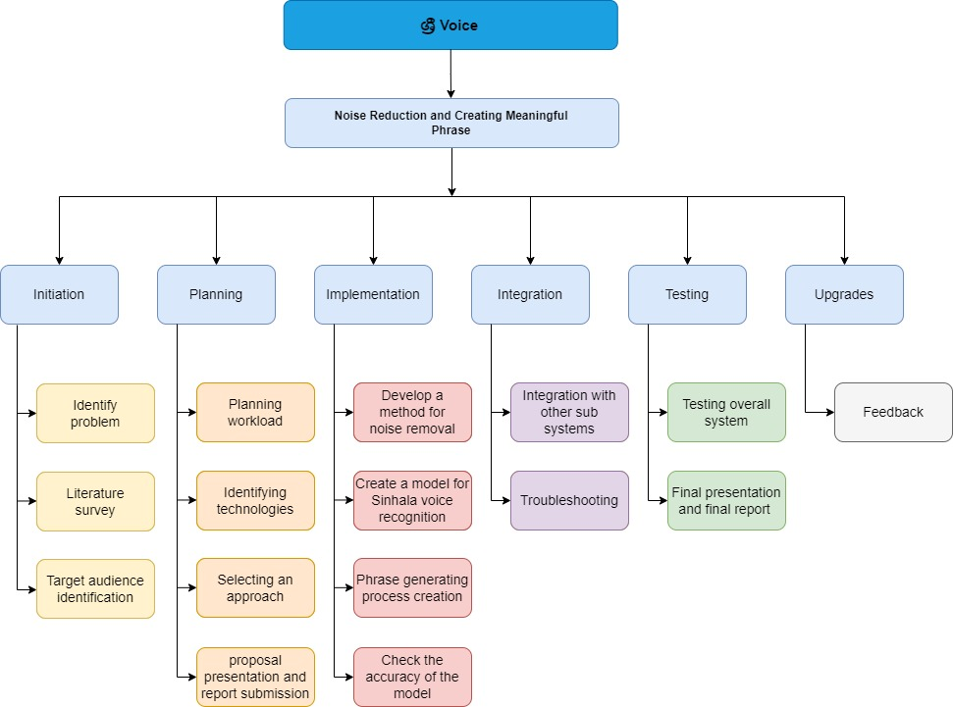
Work Breakdown Structure
IT19808994 | Bandara V.D. | 2022-200

Slide 21
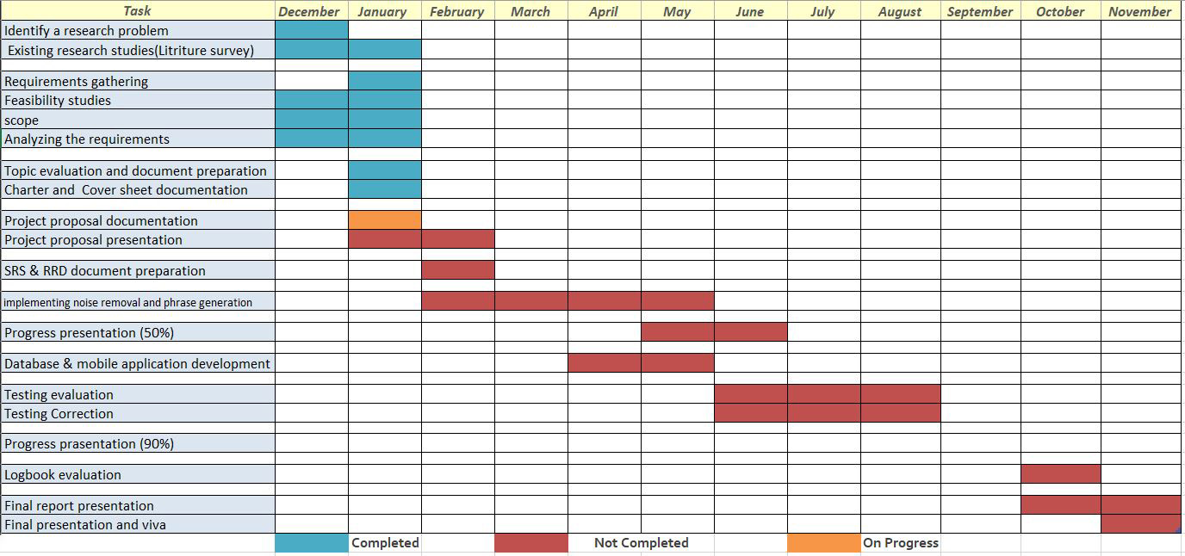
Completion of the project
IT19808994 | Bandara V.D. | 2022-200

Slide 22
References
[1] A. Shehan, Lanka Sinhala Personal Assistant, Ayesh Shehan, 2020.
[2] T. Dinushika, L. Kavmini, P. Abeyawardhana, U. Thayasivam and S. Jayasena, "Speech Command Classification System for Sinhala Language based on Automatic Speech Recognition," IEEE, 19 March 2020. [Online]. Available: https://ieeexplore.ieee.org/abstract/document/9037648. [Accessed 19 January 2022].
[3] Y. Perera, N. Jayalath, S. Tissera, O. Bandara and S. Thelijjagoda, "Intelligent mobile assistant for hearing impairers to interact with the society in Sinhala language," IEEE, 19 February 2018. [Online]. Available: https://ieeexplore.ieee.org/abstract/document/8294116. [Accessed 25 December 2022].
[4] N. Prasangini and H. Nagahamulla, "Sinhala Speech to Sinhala Unicode Text Conversion for Disaster Relief Facilitation in Sri Lanka," IEEE, 28 November 2019. [Online]. Available: https://ieeexplore.ieee.org/abstract/document/8913360. [Accessed 21 January 2022].
[5] D. D. S. Rajapakshe, K. N. B. Kudawithana, U. L. N. P. Uswatte, N. A. B. D. Nishshanka, A. V. S. Piyawardana and K. N. Pulasinghe, "Sinhala Conversational Interface for Appointment Management and Medical Advice," IEEE, 26 February 2021. [Online]. Available: https://ieeexplore.ieee.org/abstract/document/9357155. [Accessed 17 January 2022].
[6] P. M. Dias and K. Jayakody, "Virtual Assistant in Native Language," IEEE, 22 June 2021. [Online]. Available: https://ieeexplore.ieee.org/abstract/document/9452751. [Accessed 23 January 2022].
[7] M. Amarasekara, K. Bandara, B. Vithana, D. D. Silva and A. Jayakody, "Real-time interactive voice communication - For a mute person in Sinhala (RTIVC)," IEEE, 15 July 2013. [Online]. Available: https://ieeexplore.ieee.org/abstract/document/6553993. [Accessed 22 February 2022].
IT19808994 | Bandara V.D. | 2022-200

Slide 23
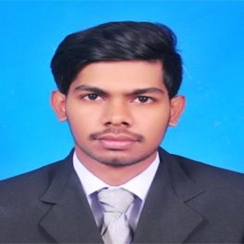
IT19216010 | herath h.m.c.p.
B.Sc. (Hons) Degree in Information Technology Specialized in
Information Technology
IT19216010 | Herath H.M.C.P.| 2022-200

Slide 24
INTRODUCTION
Generating Sinhala phonetics and provide
accurate English phrases
IT19216010 | Herath H.M.C.P.| 2022-200

Slide 25
Research Questions
How to separate voice removed Sinhala word into parts as letters?
How to provide accurate English phrases for given phonetics?
What type of words that should be used to trained that acoustic model?
How to increase the accuracy of converted phonetics?
IT19216010 | Herath H.M.C.P. | 2022-200

Slide 26
Research Gap
Existing voice assistant applications focused mainly on the English language.
Existing research projects have not used Sinhala phonetics models for the voice assistant applications.
The proposed System:
Can generate accurate phonetics for implementing a Sinhala language output to the user..
Features | [1] | [2] | [3] | Proposed System ශ්‍රී Voice
Sinhala Language
Brake Sinhala words into letters
Converting Sinhala Phonetics
Matching words with Sinhala phrase
Translation phonetics into English
IT19216010 | Herath H.M.C.P. | 2022-200

Slide 27
Specific and Sub Objectives
Specific Objective
Generating Sinhala phonetics and provide accurate English phrases.
Sub Objectives
Separate Sinhala voice input into parts as letters.
Trained a model to convert Sinhala to English phonetics.
Matched output Sinhala word with that trained acoustic model.
Translating the generated phonetics to the English phrase as a result.
IT19216010 | Herath H.M.C.P. | 2022-200

Slide 28
METHODOLOGY
IT19216010 | Herath H.M.C.P. | 2022-200

Slide 29
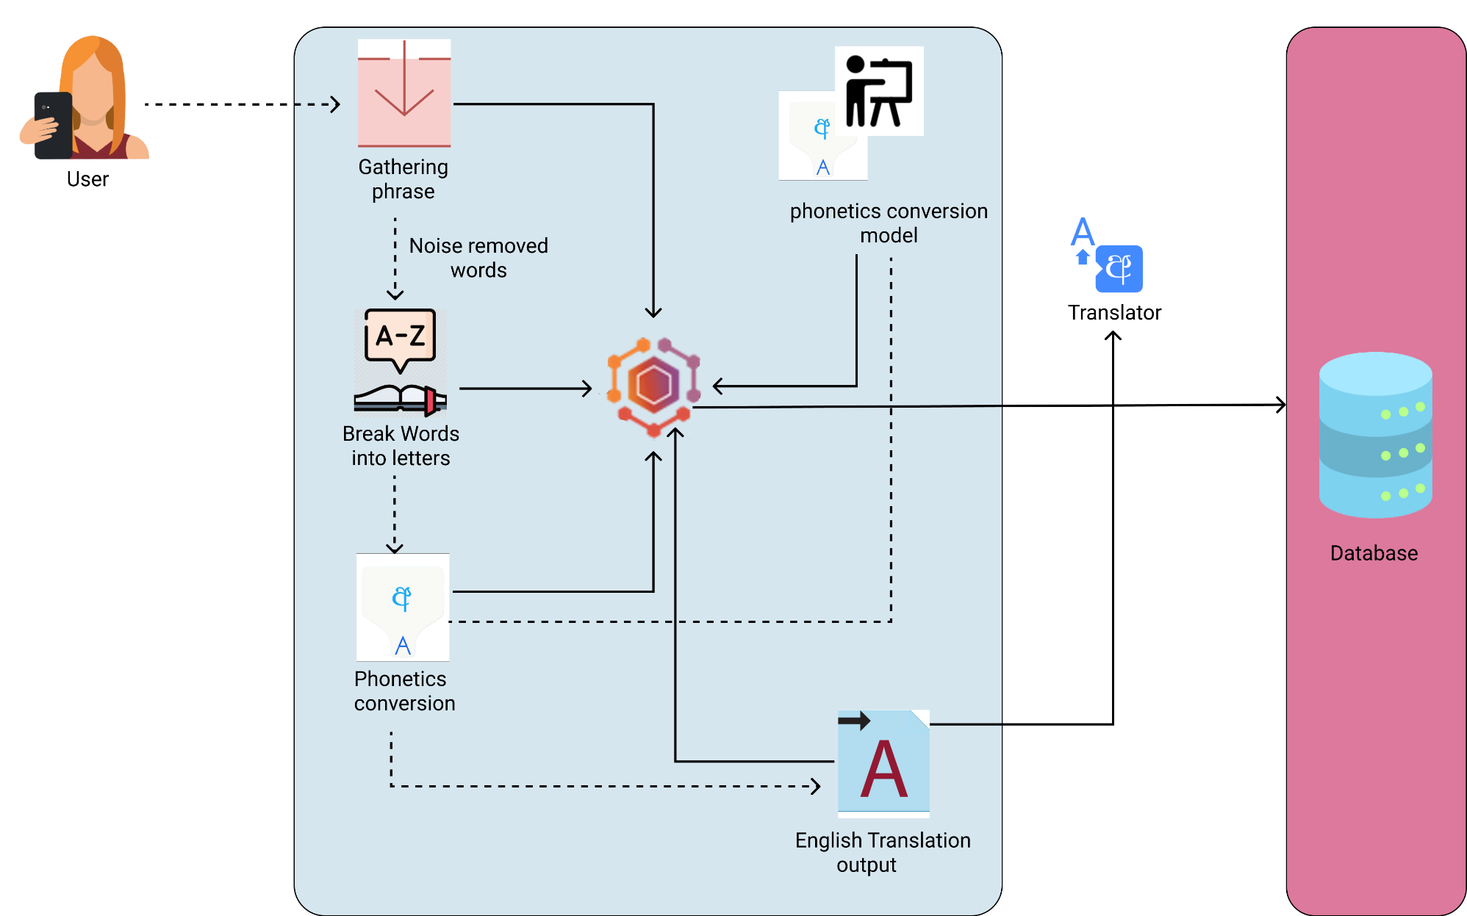
System Overview Diagram
IT19216010 | Herath H.M.C.P. | 2022-200

Slide 30




Technologies/ Techniques/ Algorithms
Technologies
Python
Jupiter Notebook
Dart
Flutter
Pytorch
Python libraries
TensorFlow
NumPy
Matplotlib
Seaborn
MongoDB/ Firebase
Tools
Visual studio code, Jupiter notebook, Google Colab, Android Studio - IDE
Version Control – GitHub
Long Short-Term Memory(LSTM) algorithm
IT19216010 | Herath H.M.C.P. | 2022-200

Slide 31
Requirements
Functional Requirements
Should have a method to gather voice removed phrases.
Should have a method to brake Sinhala words to letters.
Should have a method to generate phonetics.
Should have a method to provide accurate English phrases.
Non-Functional Requirements
Efficiency and performance of the generating phonetics.
Accuracy of generated phonetics
User Requirements
Help to find an accurate answer for the user
IT19216010 | Herath H.M.C.P. | 2022-200

Slide 32
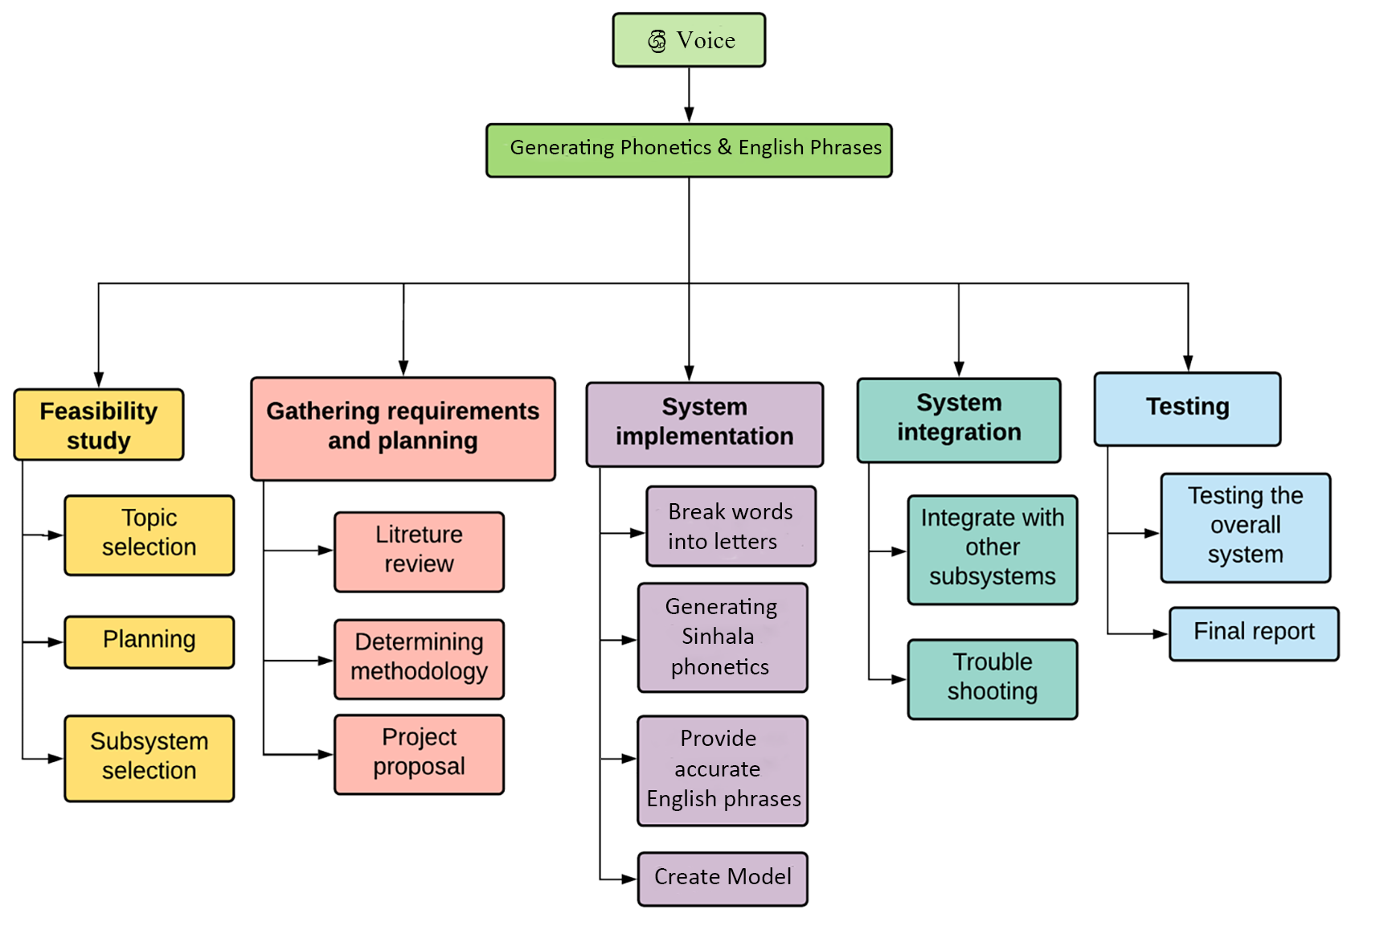
Work Breakdown Structure
IT19216010 | Herath H.M.C.P. | 2022-200

Slide 33
Evidence for the competition
IT19216010 | Herath H.M.C.P.| 2022-200

Slide 34
References
[1] D. D. S. Rajapakshe, K. N. B. Kudawithana, U. L. N. P. Uswatte, N. A. B. D. Nishshanka, A. V. S. Piyawardana and K. N. Pulasinghe, "Sinhala Conversational Interface for Appointment Management and Medical Advice," 2020 2nd International Conference on Advancements in Computing (ICAC), 2020, pp. 85-90, doi: 10.1109/ICAC51239.2020.9357155.
[2] M. Punchimudiyanse and R. G. N. Meegama, “Unicode Sinhala and phonetic English bi-directional conversion for Sinhala speech recognizer,” 2015 IEEE 10th Int. Conf. Ind. Inf. Syst. ICIIS 2015 - Conf. Proc., pp. 296–301, 2016, doi: 10.1109/ICIINFS.2015.7399027.
[3]M. S. Amarasekara, K. M. N. S. Bandara, B. V. A. I. Vithana, D. H. De Silva, and A. Jayakody, “Real-time interactive voice communication - For a mute person in Sinhala (RTIVC),” Proc. 8th Int. Conf. Comput. Sci. Educ. ICCSE 2013, no. Iccse, pp. 671–675, 2013, doi: 10.1109/ICCSE.2013.6553993.
IT19216010 | Herath H.M.C.P.| 2022-200

Slide 35
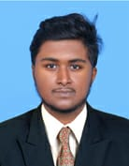
IT19159768 | Nirash J.m.i
B.Sc. (Hons) Degree in Information Technology Specialized in
Information Technology
IT19159768 | Nirash J.M.I. | 2022-200

Slide 36
INTRODUCTION
Providing accurate voice & outputs
according to the user’s commands
IT19159768 | Nirash J.M.I | 2022-200

Slide 37
Research Questions
How to give accurate voice output and text demonstration, in the Sinhala language?
How should the answer be given according to the relevant command of the user?
When the user requests an address.
when the user request to open the camera
what are the words that should be filtered and how to demonstrate the relevant answer or answers?
IT19159768 | Nirash J.M.I | 2022-200

Slide 38
Research Gap
There is no good Sinhala voice assistant mobile application in Sri Lanka that speaks Sinhala correctly and demonstration it on display.
Some existing Sinhala voice assistant's application cannot give the correct output in a google search.
According to a user command, some existing voice assistant applications do not provide relevant a suggestion or suggestions.
The proposed System:
Features | [1] | [2] | [3] | Proposed System ශ්‍රී Voice
Sinhala Language
Text to Sinhala speech
Demonstrate texts in Sinhala
Identify local commands
Access internet according to the Sinhala voice command
Filter the output accordingly
Answer to the given question in Sinhala
according to a user command, provides the quick accurate voice output, and text.
According to a user command, voice assistant applications do provide relevant a suggestion or suggestions.
IT19159768 | Nirash J.M.I. | 2022-200

Slide 39
Specific and Sub Objectives
Specific objective
Providing accurate voice output and suggestions according to the user's command.
Sub objective
Find the relevant answer from the device or the Internet.
Translating the received answer into Sinhala.
Training a model to provide Sinhala voice output.
Training a model to demonstrate a short and accurate Sinhala suggestion or suggestions.
IT19159768 | Nirash J.M.I | 2022-200

Slide 40
METHODOLOGY
IT19159768 | Nirash J.M.I | 2022-200

Slide 41
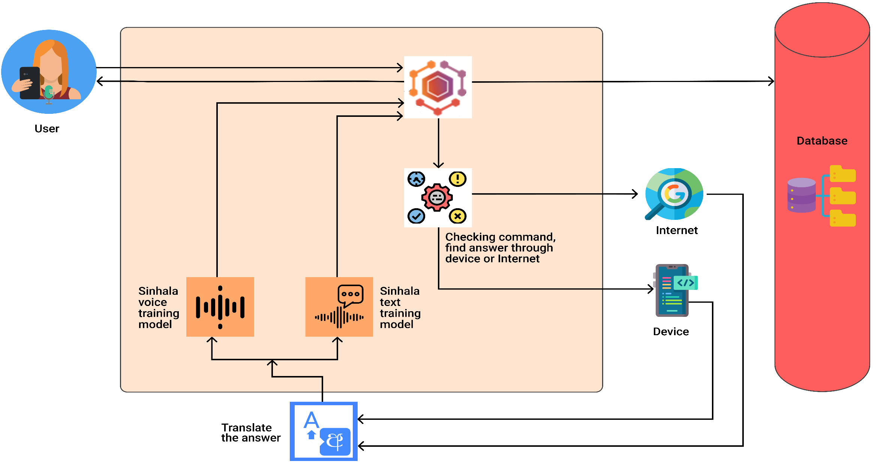
System Overview Diagram
IT19159768 | Nirash J.M.I | 2022-200

Slide 42





Technologies/ Techniques/ Algorithms
Technologies
Python
Jupiter Notebook
Dart
Flutter
Python libraries
TensorFlow
NumPy
Matplotlib
Seaborn
MongoDB/ Firebase
Tools
Visual studio code, Jupiter notebook, Google Colab, Android Studio - IDE
Version Control - GitHub
IT19159768 | Nirash J.M.I | 2022-200

Slide 43
Requirements
Functional Requirements
According to the user's command, there should be a method to find out whether the relevant answer should be given from the device or from the internet.
There should be a method to say the relevant answer correctly and quickly in Sinhala.
There should be a method to display the answer in Sinhala on the display.
Non-Functional Requirements
Efficiency of providing suggestion or suggestions according to user command.
The efficiency of providing relevant output in Sinhala voice and demonstrate Sinhala text in display.
User
Answer in Sinhala voice.
Display relevant answers or suggestions.
IT19159768 | Nirash J.M.I | 2022-200

Slide 44
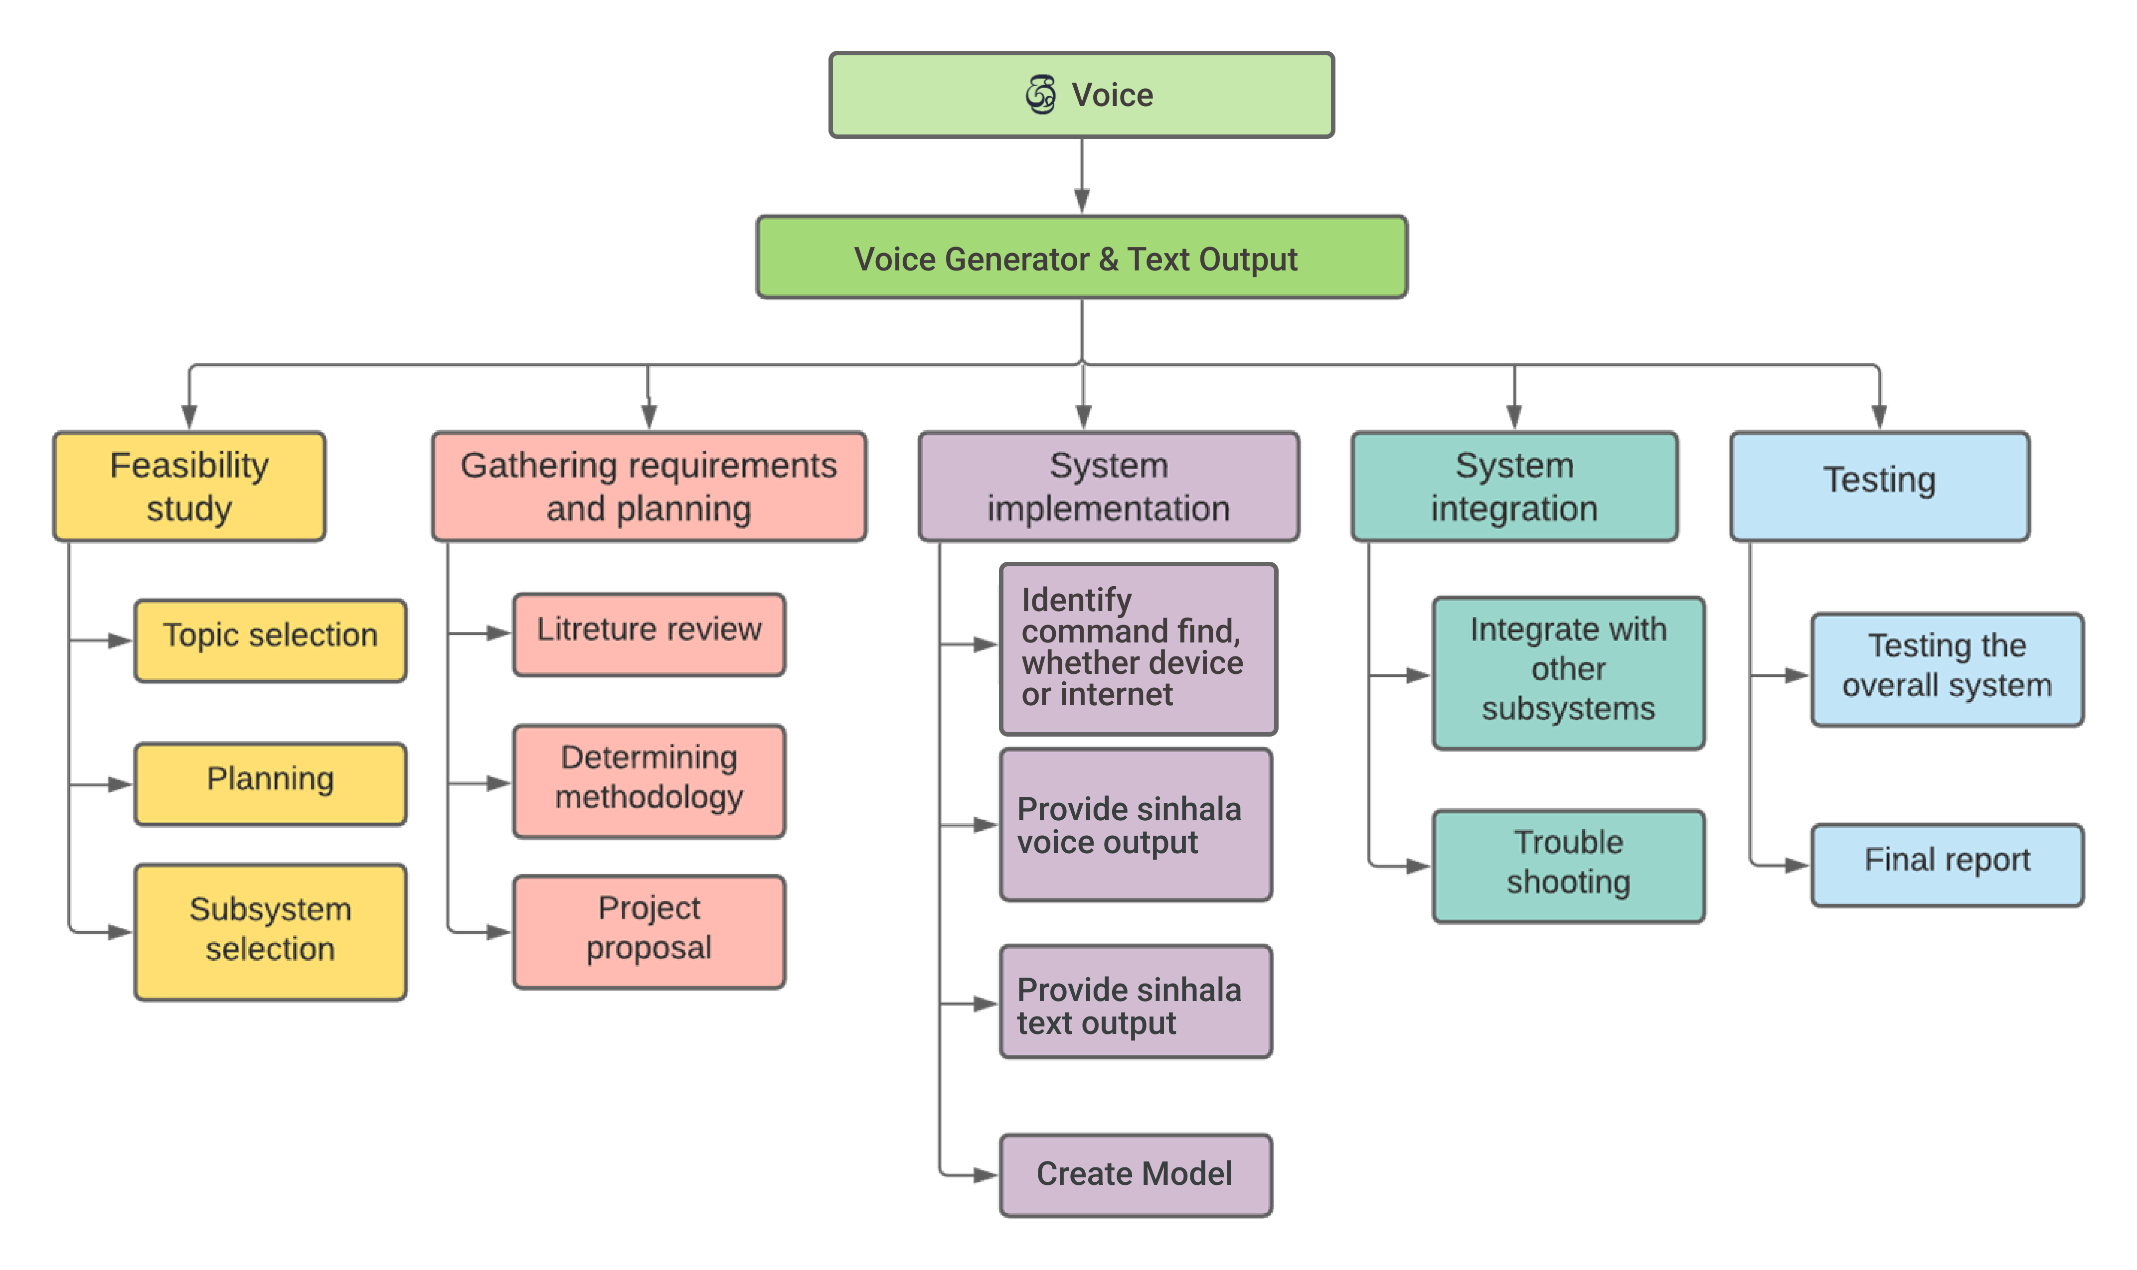
Work Breakdown Structure
IT19159768 | Nirash J.M.I | 2022-200

Slide 45

Evidence for the competition
IT19159768 | Nirash J.M.I | 2022-200

Slide 46
References
[1]"Intelligent mobile assistant for hearing impairers to interact with the society in Sinhala language", Ieeexplore.ieee.org, 2022. [Online]. Available: https://ieeexplore.ieee.org/abstract/document/8294116.
[2] "Voice assistant application for the Serbian language", Ieeexplore.ieee.org, 2022. [Online]. Available: https://ieeexplore.ieee.org/abstract/document/7377600.
[3] "Using voice assistant skills in family life - UCL Discovery", Discovery.ucl.ac.uk, 2022. [Online]. Available: https://discovery.ucl.ac.uk/id/eprint/10084820/.
IT19159768 | Nirash J.M.I | 2022-200

Slide 47
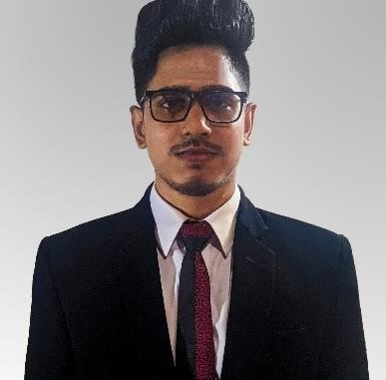
IT19152592 | Senarathne k.h.i.r.
B.Sc. (Hons) Degree in Information Technology Specialized in
Information Technology
IT19152592 | Senarathne K.H.I.R.| 2022-200

Slide 48
INTRODUCTION
Providing most suitable & ideal suggestions
to the user according to real-time emotions &
situations
IT19152592 | Senarathne K.H.I.R.| 2022-200

Slide 49
Research Questions
How to identify users' feelings and emotions via camera?
How to track various type of users' behaviors and preferences?
How to provide ideal suggestions according to users' real-time emotions?
How to increase mental freedom through the Sinhala voice suggestions?
IT19152592 | Senarathne K.H.I.R.| 2022-200

Slide 50
Research Gap
Features | [1] | [2] | [3] | Proposed System ශ්‍රී Voice
Sinhala Language
Facial expression detection
User tracking behavior identifying
User preference analyzing & detection
Provide suggestions to increase mental health according to the user’s emotions
Sinhala voice output
Most existing voice assistant applications provide ordinary suggestions.
Existing voice assistants do not have a feature to analyze feelings and emotions from the face.
Existing voice assistants do not provide ideal suggestions using Sinhala language.
Existing voice assistant applications do not interact like a closed friend.
The proposed System:
Can provide ideal suggestions for real-time emotions the using the Sinhala language while being a friend
IT19152592 | Senarathne K.H.I.R.| 2022-200

Slide 51
Specific and Sub Objectives
Specific Objectives
Provide most suitable and ideal suggestions to the user according to real-time emotions and function like a closed and trusted friend to user.
Sub Objectives
Identify users’ facial expressions.
Identify users’ emotions according to the expressions.
Track user.
gather preferences.
Generate Sinhala voice suggestions.
IT19152592 | Senarathne K.H.I.R.| 2022-200

Slide 52
METHODOLOGY
IT19152592 | Senarathne K.H.I.R.| 2022-200

Slide 53
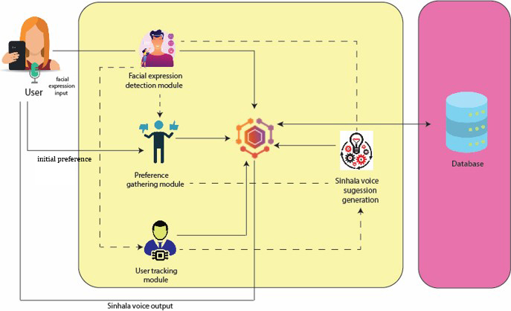
System Overview Diagram
IT19152592 | Senarathne K.H.I.R.| 2022-200

Slide 54
Technologies/ Techniques/ Algorithms
Technologies
Python
Jupiter Notebook
Dart
Flutter
Python libraries
TensorFlow
NumPy
Matplotlib
Seaborn
MongoDB/ Firebase
Tools
Visual studio code, Jupiter notebook, Google Colab, Android Studio - IDE
Version Control – GitHub
CK+ and JAFFE
FaceAPI
IT19152592 | Senarathne K.H.I.R.| 2022-200

Slide 55
Requirements
Functional Requirements
Should have a method to identify expressions from the face.
Should have a method to identify emotions from the facial expressions.
Should have a method to track and identify user behavior.
Should have a method to provide ideal suggestions according to the real-time situation.
Non-Functional Requirements
The Efficiency and performance of identification of the facial expressions.
The Efficiency of providing ideal suggestions according to real time situation.
User Requirements
To provide ideal suggestions according to the real-time situations.
To provide enjoyment.
IT19152592 | Senarathne K.H.I.R.| 2022-200

Slide 56
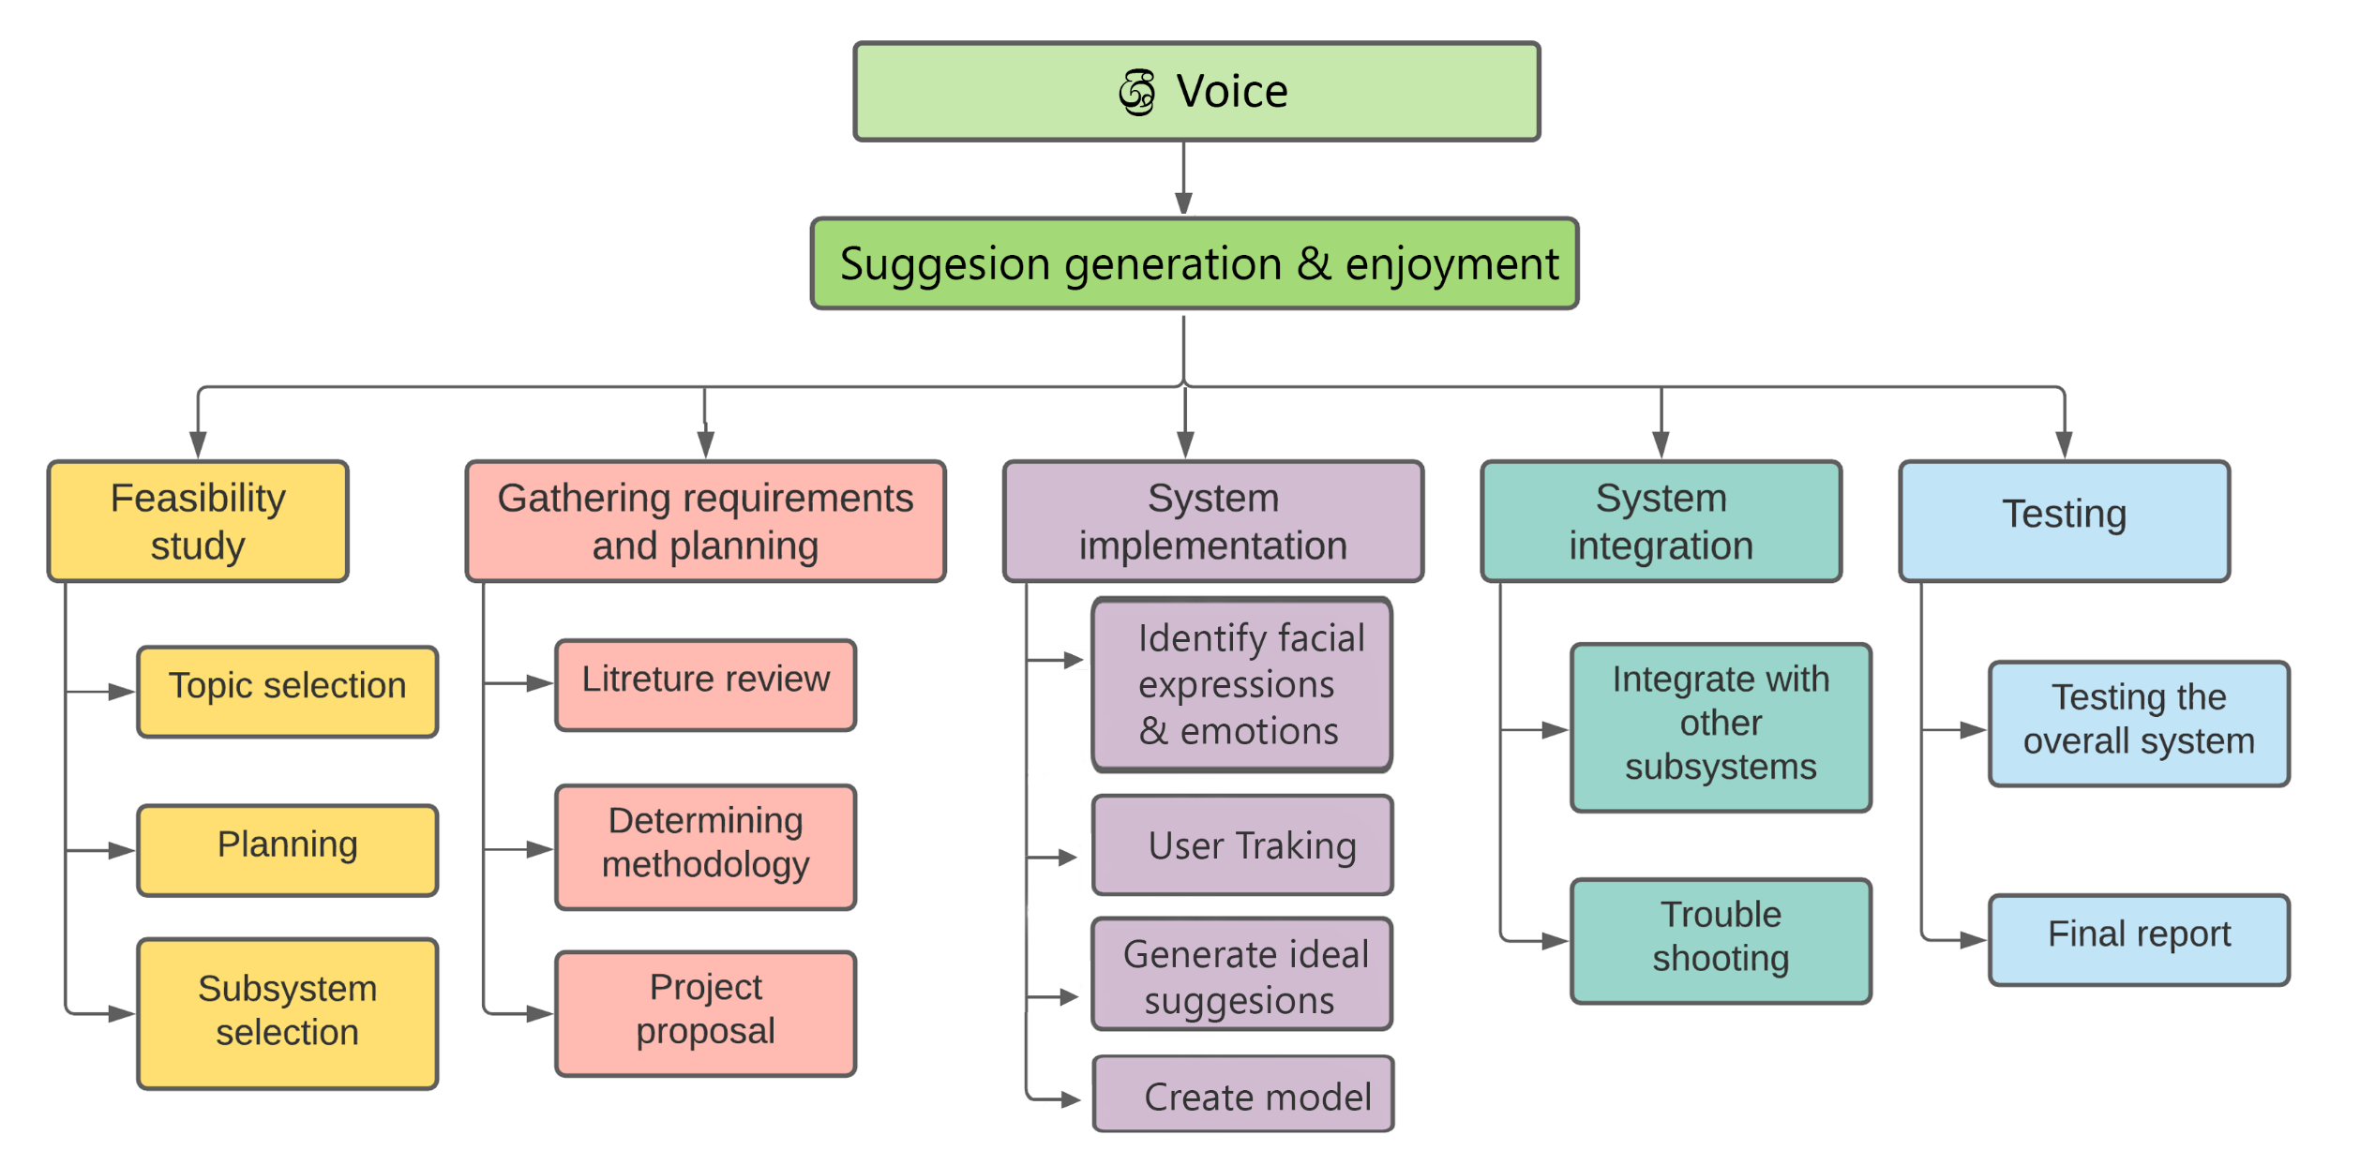
Work Breakdown Structure
IT19152592 | Senarathne K.H.I.R.| 2022-200

Slide 57
Evidence for the competition
IT19152592 | Senarathne K.H.I.R.| 2022-200

Slide 58
References
[1] M. S. Bartlett, G. Littlewort, C. Lainscsek, I. Fasel, and J. Movellan, “Machine learning methods for fully automatic recognition of facial expressions and facial actions,” Conf. Proc. - IEEE Int. Conf. Syst. Man Cybern., vol. 1, pp. 592–597, 2004, doi: 10.1109/icsmc.2004.1398364.
[2] M. Tkalčič, M. Elahi, N. Maleki, F. Ricci, M. Pesek, and M. Marolt, “Prediction of music pairwise preferences from facial expressions,” Int. Conf. Intell. User Interfaces, Proc. IUI, vol. Part F147615, pp. 150–159, 2019, doi: 10.1145/3301275.3302266.
[3] D. D. S. Rajapakshe, K. N. B. Kudawithana, U. L. N. P. Uswatte, N. A. B. D. Nishshanka, A. V. S. Piyawardana and K. N. Pulasinghe, "Sinhala Conversational Interface for Appointment Management and Medical Advice," 2020 2nd International Conference on Advancements in Computing (ICAC), 2020, pp. 85-90, doi: 10.1109/ICAC51239.2020.9357155.
[4] J. H. Kim, B. G. Kim, P. P. Roy, and D. M. Jeong, “Efficient facial expression recognition algorithm based on hierarchical deep neural network structure,” IEEE Access, vol. 7, no. c, pp. 41273–41285, 2019, doi: 10.1109/ACCESS.2019.2907327.
IT19152592 | Senarathne K.H.I.R.| 2022-200

Slide 59

Thank you!

